Slide 1
Demand and Supply
Market Equilibrium

Slide 2
Determinants of Household Demand
A household’s decision about the quantity of a particular output to demand depends on:
The price of the product in question.
The income available to the household.
The household’s amount of accumulated wealth.
The prices of related products available to the household.
The household’s tastes and preferences.
The household’s expectations about future income, wealth, and prices.

Slide 3
Quantity Demanded
Quantity demanded is the amount (number of units) of a product that a household would buy in a given time period if it could buy all it wanted at the current market price.

Slide 4
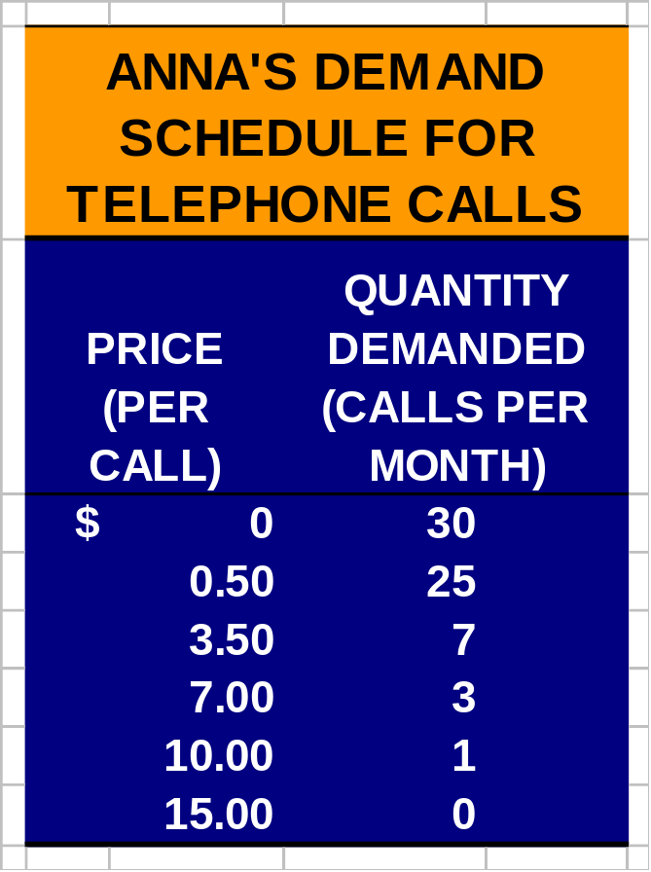
Demand in Output Markets
A demand schedule is a table showing how much of a given product a household would be willing to buy at different prices.
Demand curves are usually derived from demand schedules.

Slide 5
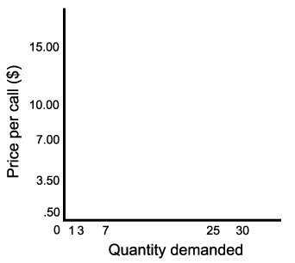
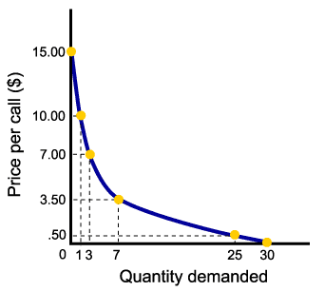
The Demand Curve
The demand curve is a graph illustrating how much of a given product a household would be willing to buy at different prices.

Slide 6
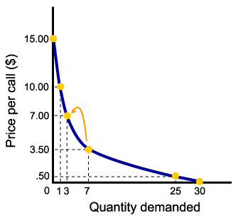


The Law of Demand
The law of demand states that there is a negative, or inverse, relationship between price and the quantity of a good demanded and its price.
This means that demand curves slope downward.

Slide 7
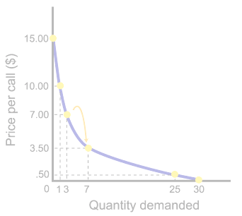
Other Properties of Demand Curves
Demand curves intersect the quantity (X)-axis, as a result of time limitations and diminishing marginal utility.
Demand curves intersect the (Y)-axis, as a result of limited incomes and wealth.

Slide 8
Related Goods and Services
Normal Goods are goods for which demand goes up when income is higher and for which demand goes down when income is lower.
Inferior Goods are goods for which demand falls when income rises.

Slide 9
Related Goods and Services
Substitutes are goods that can serve as replacements for one another; when the price of one increases, demand for the other goes up. Perfect substitutes are identical products.
Complements are goods that “go together”; a decrease in the price of one results in an increase in demand for the other, and vice versa.

Slide 10
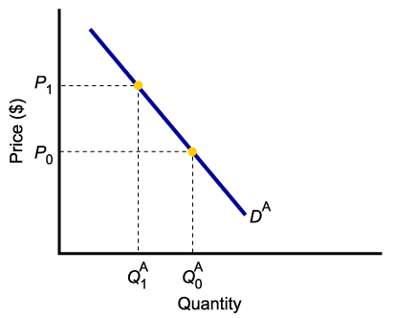
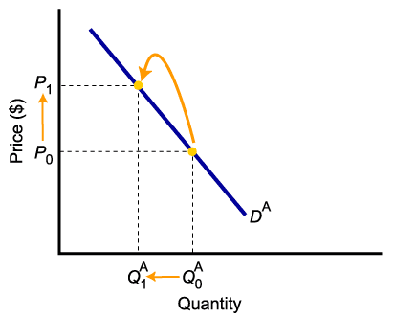
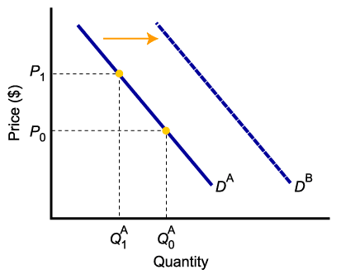
Shift of Demand Versus Movement Along a Demand Curve
A change in demand is not the same as a change in quantity demanded.
In this example, a higher price causes lower quantity demanded.
Changes in determinants of demand, other than price, cause a change in demand, or a shift of the entire demand curve, from D_{A} to D_{B}.

Slide 11
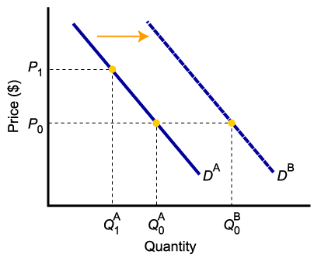
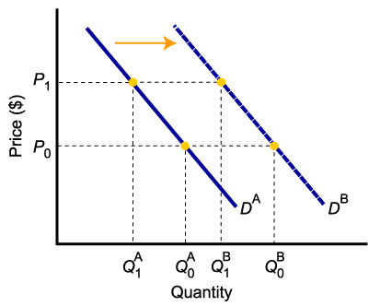
A Change in Demand Versus a Change in Quantity Demanded
When demand shifts to the right, demand increases. This causes quantity demanded to be greater than it was prior to the shift, for each and every price level.

Slide 12
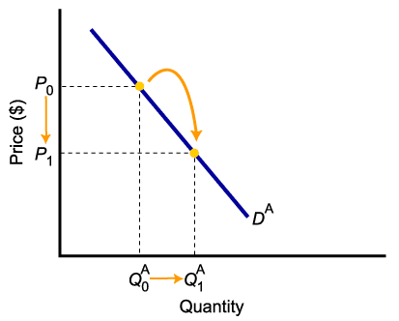
A Change in Demand Versus a Change in Quantity Demanded
To summarize:
Change in price of a good or service
leads to
Change in quantity demanded
(Movement along the curve).
Change in income, preferences, or
prices of other goods or services
leads to
Change in demand
(Shift of curve).

Slide 13
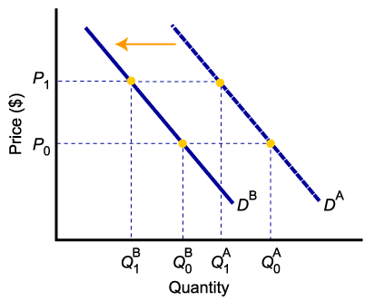
The Impact of a Change in Income
Higher income decreases the demand for an inferior good
Higher income increases the demand for a normal good

Slide 14
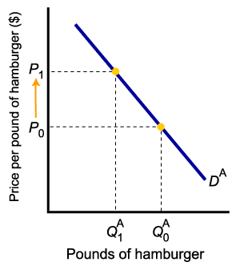
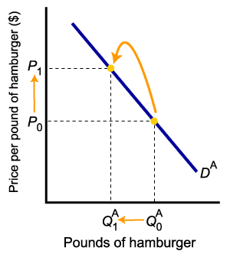
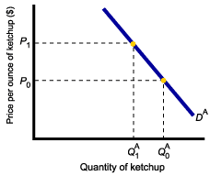
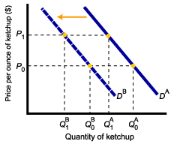
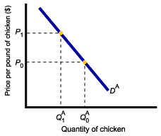
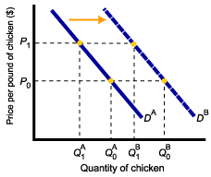
The Impact of a Change in the Price of Related Goods
Demand for complement good (ketchup) shifts left
Demand for substitute good (chicken) shifts right
Price of hamburger rises
Quantity of hamburger demanded falls

Slide 15
From Household to Market Demand
Demand for a good or service can be defined for an individual household, or for a group of households that make up a market.
Market demand is the sum of all the quantities of a good or service demanded per period by all the households buying in the market for that good or service.

Slide 16
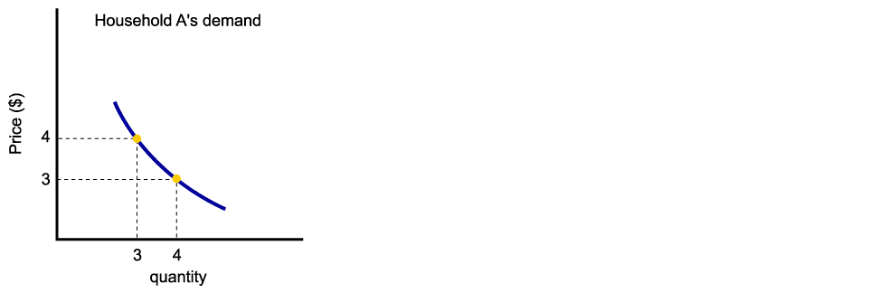
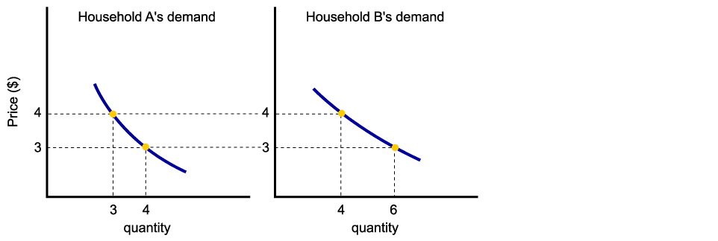
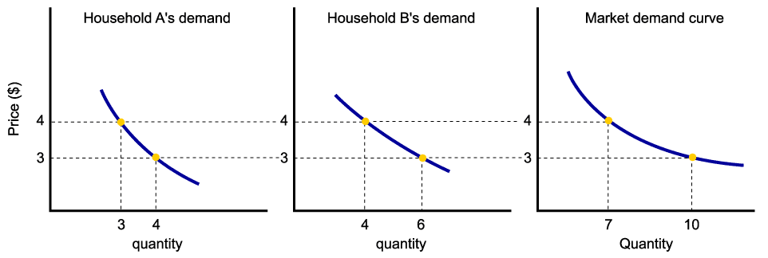
From Household Demand to Market Demand
Assuming there are only two households in the market, market demand is derived as follows:

Slide 17
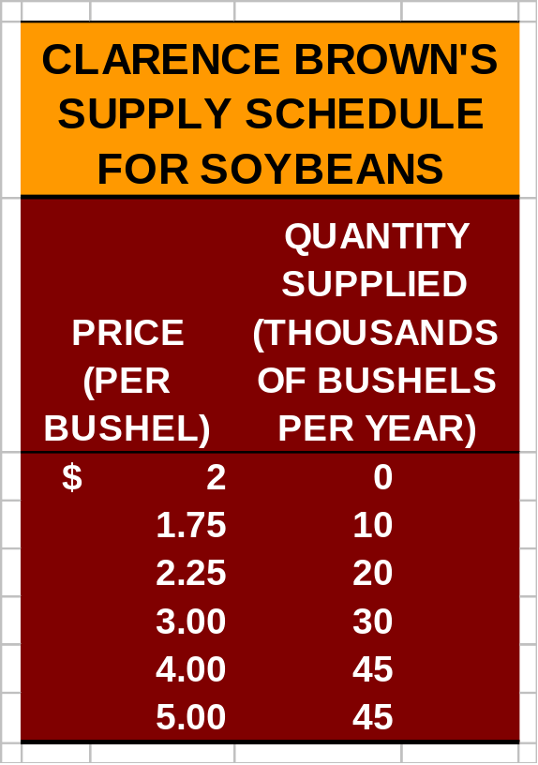
Supply in Output Markets
A supply schedule is a table showing how much of a product firms will supply at different prices.
Quantity supplied represents the number of units of a product that a firm would be willing and able to offer for sale at a particular price during a given time period.

Slide 18
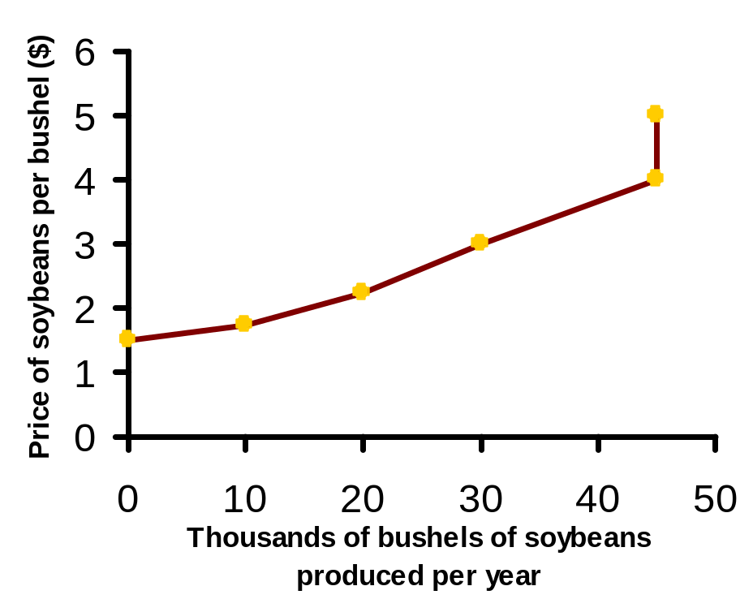
The Supply Curve and the Supply Schedule
A supply curve is a graph illustrating how much of a product a firm will supply at different prices.

Slide 19

The Law of Supply
The law of supply states that there is a positive relationship between price and quantity of a good supplied.
This means that supply curves typically have a positive slope.

Slide 20
Determinants of Supply
The price of the good or service.
The cost of producing the good, which in turn depends on:
  The price of required inputs (labor, capital, and land),
  The technologies that can be used to produce the product,
The prices of related products.

Slide 21
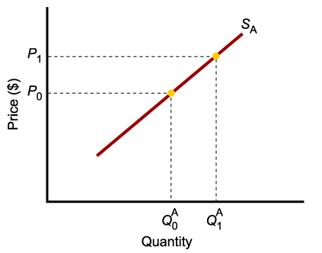
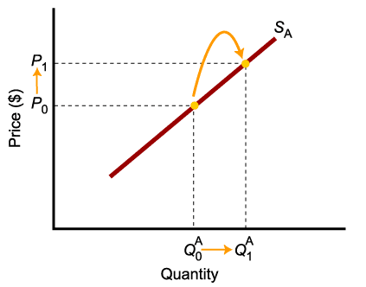
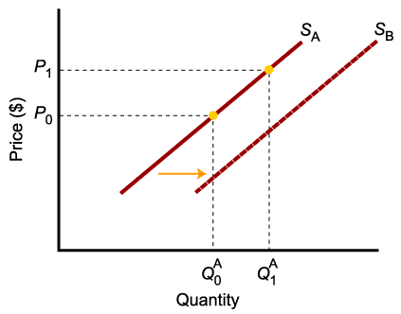
A Change in Supply Versus a Change in Quantity Supplied
A change in supply is not the same as a change in quantity supplied.
In this example, a higher price causes higher quantity supplied, and a move along the demand curve.
In this example, changes in determinants of supply, other than price, cause an increase in supply, or a shift of the entire supply curve, from S_{A} to S_{B}.

Slide 22
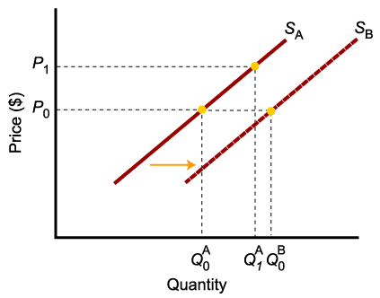
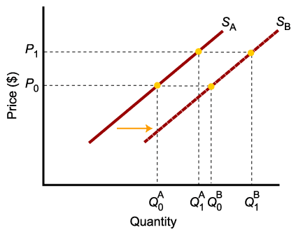
A Change in Supply Versus a Change in Quantity Supplied
When supply shifts to the right, supply increases. This causes quantity supplied to be greater than it was prior to the shift, for each and every price level.

Slide 23

A Change in Supply Versus a Change in Quantity Supplied
To summarize:
Change in price of a good or service
leads to
Change in quantity supplied
(Movement along the curve).
Change in costs, input prices, technology, or prices of related goods and services
leads to
Change in supply
(Shift of curve).

Slide 24
From Individual Supply to Market Supply
The supply of a good or service can be defined for an individual firm, or for a group of firms that make up a market or an industry.
Market supply is the sum of all the quantities of a good or service supplied per period by all the firms selling in the market for that good or service.

Slide 25
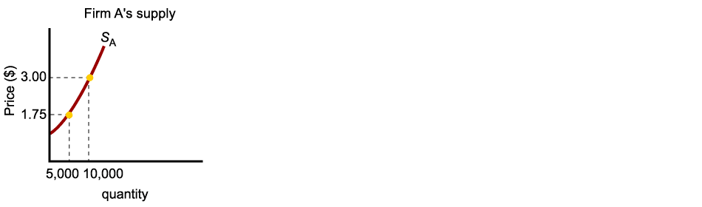
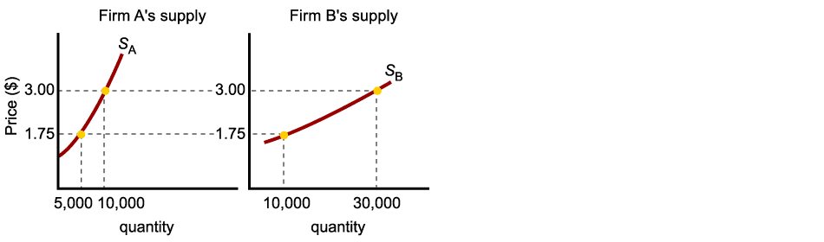
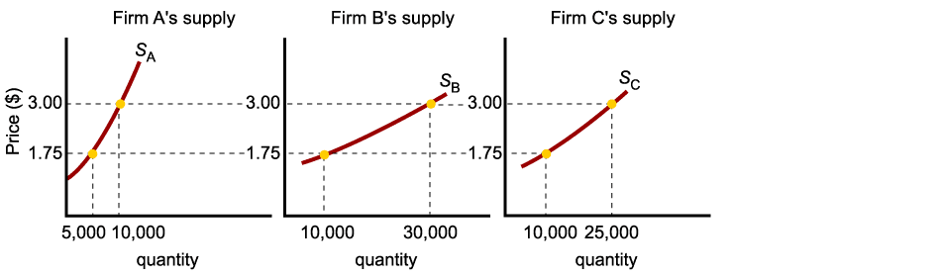
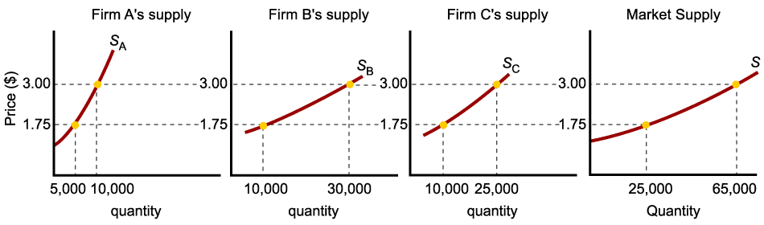
Market Supply
As with market demand, market supply is the horizontal summation of individual firms’ supply curves.

Slide 26
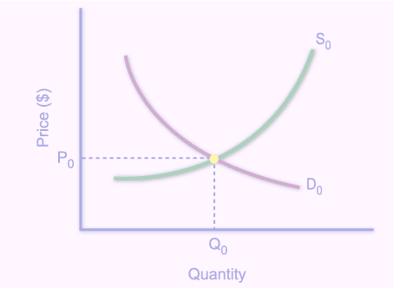
Market Equilibrium
The operation of the market depends on the interaction between buyers and sellers.
An equilibrium is the condition that exists when quantity supplied and quantity demanded are equal.
At equilibrium, there is no tendency for the market price to change.

Slide 27
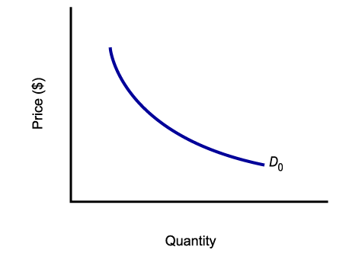
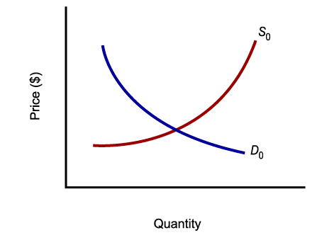
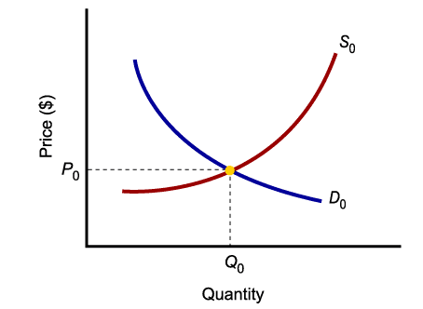
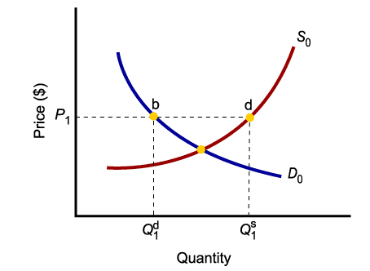
Market Equilibrium
Only in equilibrium is quantity supplied equal to quantity demanded.
At any price level other than P₀, the wishes of buyers and sellers do not coincide.

Slide 28
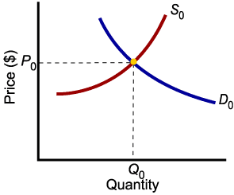
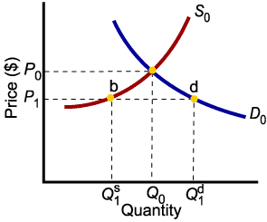
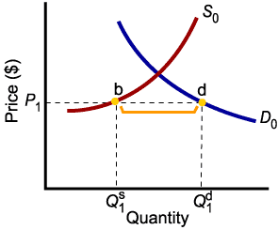
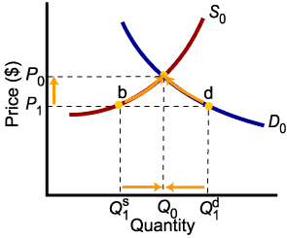
Market Disequilibria
Excess demand, or shortage, is the condition that exists when quantity demanded exceeds quantity supplied at the current price.
When quantity demanded exceeds quantity supplied, price tends to rise until equilibrium is restored.

Slide 29
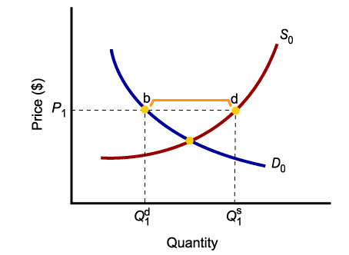
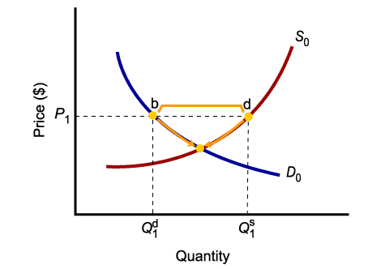
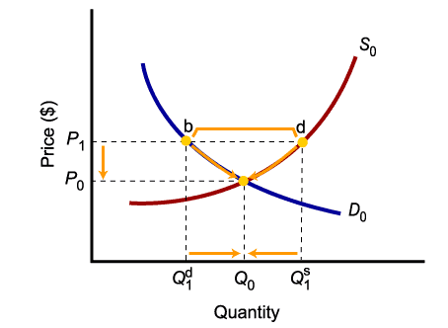
Market Disequilibria
Excess supply, or surplus, is the condition that exists when quantity supplied exceeds quantity demanded at the current price.
When quantity supplied exceeds quantity demanded, price tends to fall until equilibrium is restored.

Slide 30
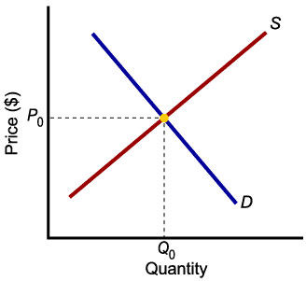
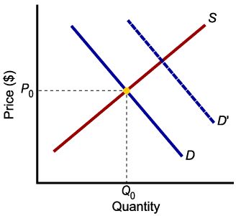
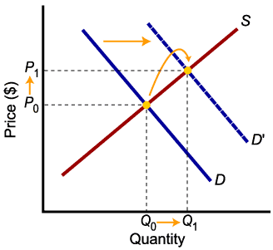

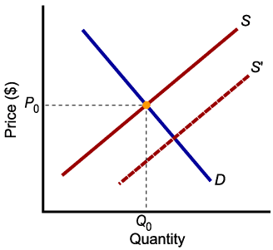
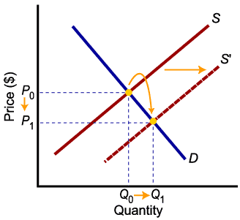
Increases in Demand and Supply
Higher demand leads to higher equilibrium price and higher equilibrium quantity.
Higher supply leads to lower equilibrium price and higher equilibrium quantity.

Slide 31

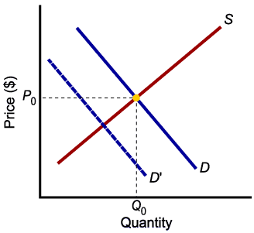




Decreases in Demand and Supply
Lower demand leads to lower price and lower quantity exchanged.
Lower supply leads to higher price and lower quantity exchanged.

Slide 32










Relative Magnitudes of Change
The relative magnitudes of change in supply and demand determine the outcome of market equilibrium.

Slide 33










Relative Magnitudes of Change
When supply and demand both increase, quantity will increase, but price may go up or down.

